Slide 1

Architecture Changes in Wireless Networks
The Evolution of Cellular and Wireless Networks
Video 2.3

Slide 2
Basic Architecture
PSTN
Public Switched Telephone Network
Radio
Access
Network
(RAN)
Core
Network
(CN)
User
Equipment
(UE)

Slide 3
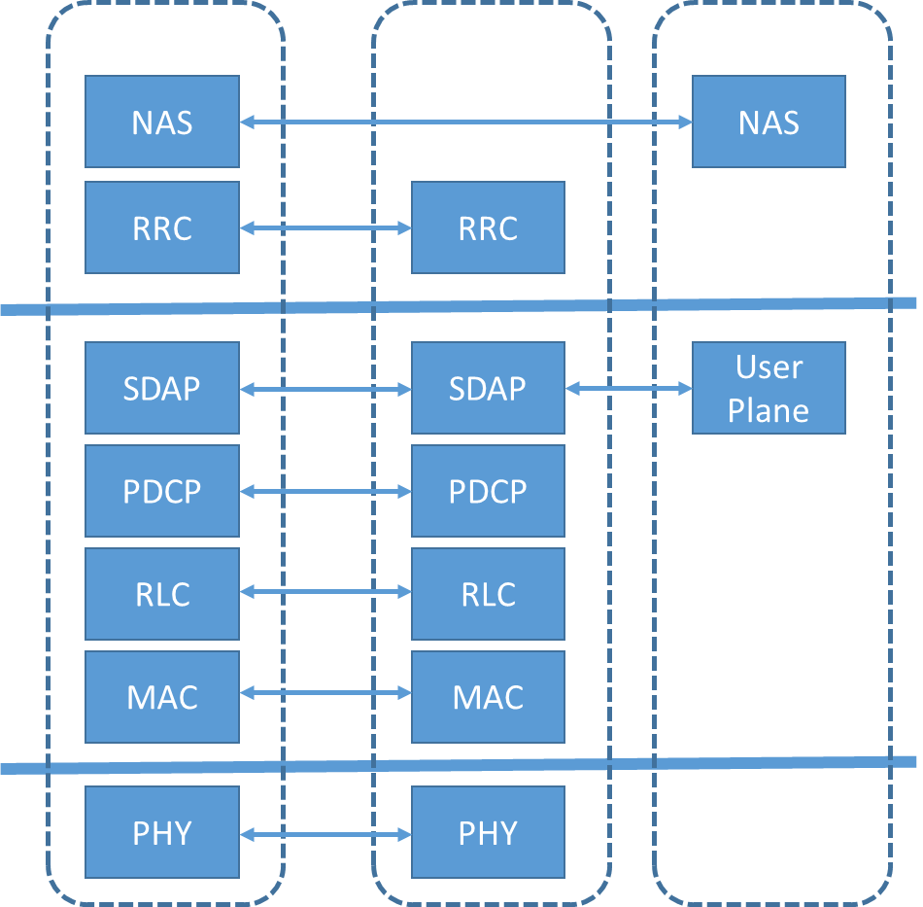
Air Interface
Open Systems
Interconnection Layer
Layer 3
Network
NAS: Non-Access Stratum
RRC: Radio Resource Control
SDAP: Service Data Adaptation Protocol
PDCP: Packet Data Convergence Protocol
RLC: Radio Link Control
MAC: Medium Access Control
PHY: Physical
Layer 2
Data
Layer 1
Physical

Slide 4
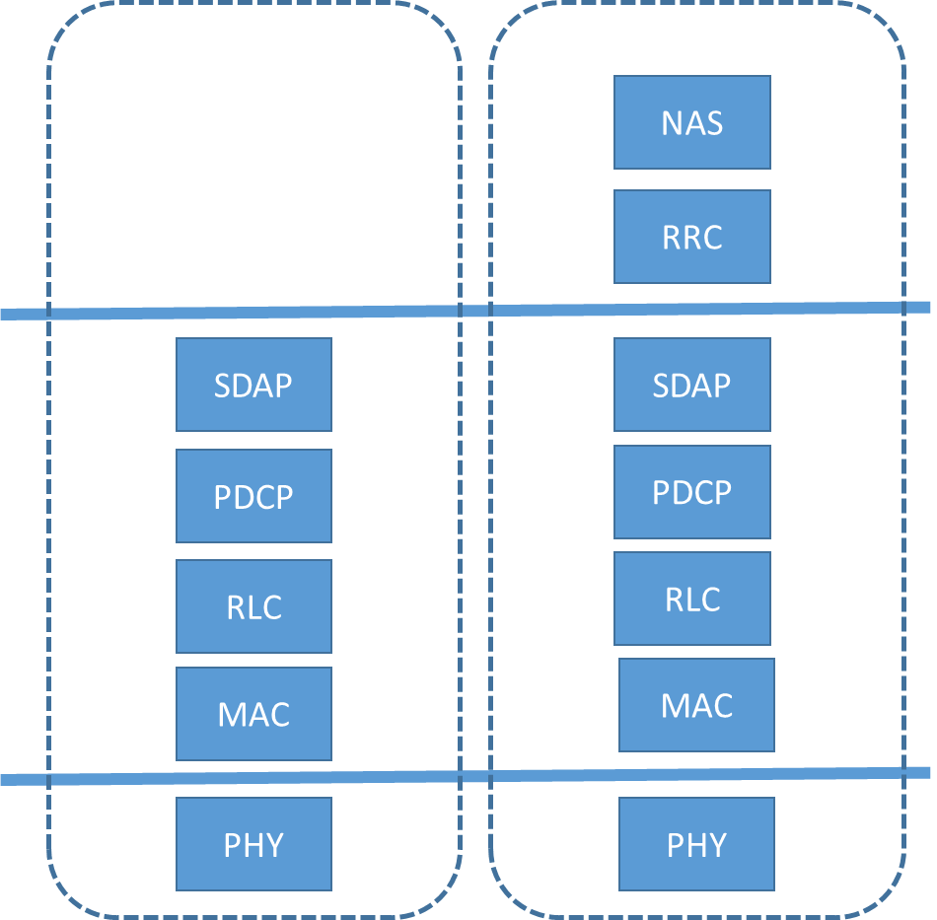
Air Interface
Open Systems
Interconnection Layer
User Plane: Exchanges data between Core Network and UE; also called Data Plane.
Layer 3
Network
Control Plane: Sets up and tears down connections, responsible for routing.
NAS: Non-Access Stratum
RRC: Radio Resource Control
SDAP: Service Data Adaptation Protocol
PDCP: Packet Data Convergence Protocol
RLC: Radio Link Control
MAC: Medium Access Control
PHY: Physical
Layer 2
Data
Layer 1
Physical

Slide 5
Basic Architecture
PSTN
Public Switched Telephone Network
Radio
Access
Network
(RAN)
Core
Network
(CN)
User
Equipment
(UE)

Slide 6
2G Architecture
MSC
BTS
BSC
PSTN
BTS
BSS
Public Switched Telephone Network
BTS: Base Transceiver Station
BSC: Base Station Controller
BSS: Base Station Subsystem
MSC: Mobile Switching Center
User
Equipment
(UE)
Radio
Access Network
(RAN)
Core
Network
(CN)

Slide 7
2.5G Architecture
MSC
BTS
BSC
PSTN
BTS
BSS
SGSN
GGSN
Public Switched Telephone Network
User
Equipment
(UE)
Radio
Access Network
(RAN)
General Packet Radio Service
(GPRS)
IP
Network
Core
Network
(CN)
SGSN: Serving GPRS Support Node
GGSN: Gateway GPRS Support Node

Slide 8
3G Architecture
MSC
Node B
RNC
PSTN
Node B
RNS
SGSN
GGSN
Public Switched Telephone Network
User
Equipment
(UE)
Radio
Access Network
(RAN)
IP
Network
Core
Network
(CN)
RNC: Radio Network Controller
RNS: Radio Network Service

Slide 9
4G Architecture
MME
eNodeB
PGW
IP
Network
eNodeB
SGW
EPC
MME: Mobility Management Entity
PGW: Packet Gateway
SGW: Serving Gateway
EPC: Evolved Packet Core
User
Equipment
(UE)
Radio
Access Network
(RAN)
Core
Network
(CN)

Slide 10
5G NSA Architecture
MME
eNodeB
PGW
IP
Network
eNodeB
SGW
EPC
MME: Mobility Management Entity
PGW: Packet Gateway
SGW: Serving Gateway
EPC: Evolved Packet Core
gNodeB
User
Equipment
(UE)
Radio
Access Network
(RAN)
Core
Network
(CN)

Slide 11
5G NR Architecture
5G Core
gNodeB
DU
NRF
NSSF
AUSF
IP
Network
gNodeB
UDM
NEF
AMF
DU
CU
DU: Distributed Unit
CU: Centralized Unit
NRF: Network Repository Function
UDM: Unified Data Management
SMF: Session Management Function
NSSF: Network Slice Selection Function
NEF: Network Exposure Function
PCF: Policy Control Function
AUSF: Authentication Server Function
AMF: Access and Mobility Function
SMF
PCF
gNodeB
DU
User
Equipment
(UE)
Radio
Access Network
(RAN)
Core
Network
(CN)

Slide 12
KEY TAKEAWAYS
01
2G and 3G Driven by Voice Prioritization
2G and 3G networks were driven primarily by voice communication.
02
4G Driven by Data Prioritization
Full packet data network evolution occurred with the deployment of 4G.
03
4G and 5G Relationship
5G will not fully replace 4G for several years and will utilize 4G EPC as part of 5G NSA architecture.

Slide 13
Potential Vulnerabilities and Risks
Next Video

